Slide 1


Rating Predictions of BestBuy Laptop Reviews
Emre Yener

Slide 2

Problem Statement
To establish a relationship between ratings and review content.
To incorporate metadata scraped out of the laptop reviews to the machine learning model

Slide 3
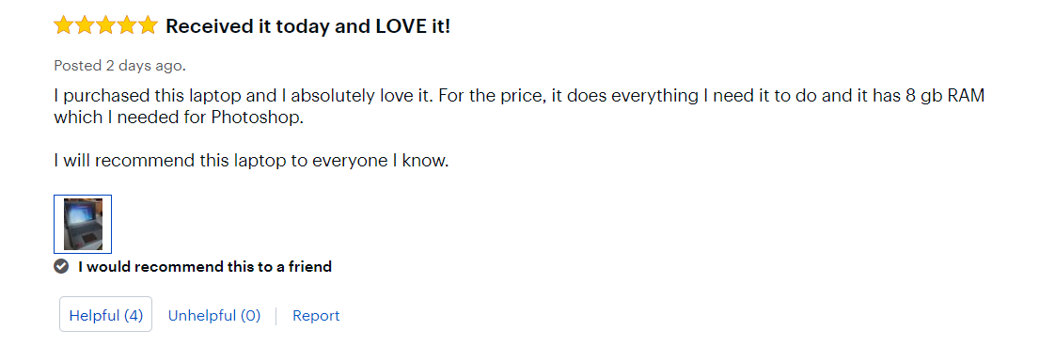
A Review Example

Slide 4
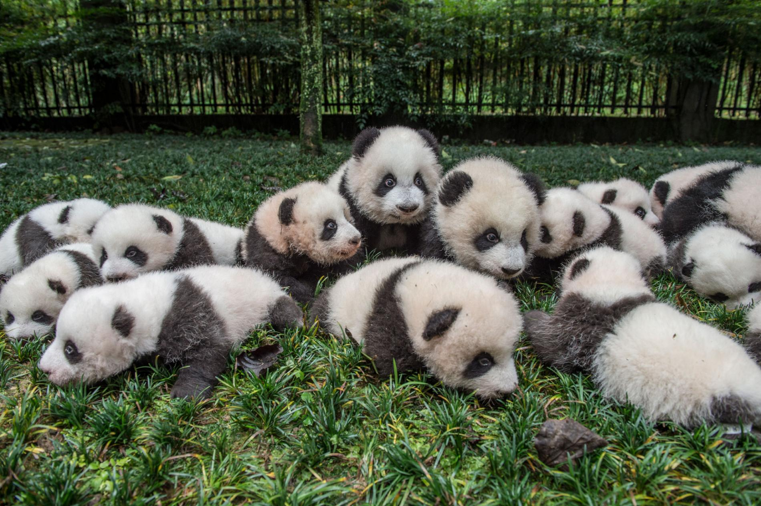
Libraries In-Use
Scrapy
Pandas
Numpy
Regex
spaCy
Scikit Learn
Matplotlib
Shap

Slide 5
Scikit Learn Functions In-Use
sklearn.feature_extraction.text => TfidfVectorizer, CountVectorizer
sklearn.cluster => Kmeans
sklearn.model_selection => StratifiedShuffleSplit, GridSearchCV
sklearn.tree => DecisionTreeClassifier
sklearn.metrics => confusion_matrix, precision_score, recall_score, roc_auc_score

Slide 6
Text Pre-Processing

Slide 7
Original Text
“Wasn't happy that it came with Windows 10S, but it was fairly simple to switch to regular Windows 10.
Love the compact size! Perfect for throwing in my workbag and taking it places. Battery life seems to be good too.
Wish it was a backlit keyboard.”

Slide 8
Steps
Text Normalization – Regex
Lemmatization – spaCy
Cleaning – Regex
be happy come windows be simple switch regular windows love compact size perfect throw workbag take place battery life seem be good wish be backlit keyboard
Key Phrase Extraction – TFIDF Vectorizer

Slide 9
Modeling

Slide 10
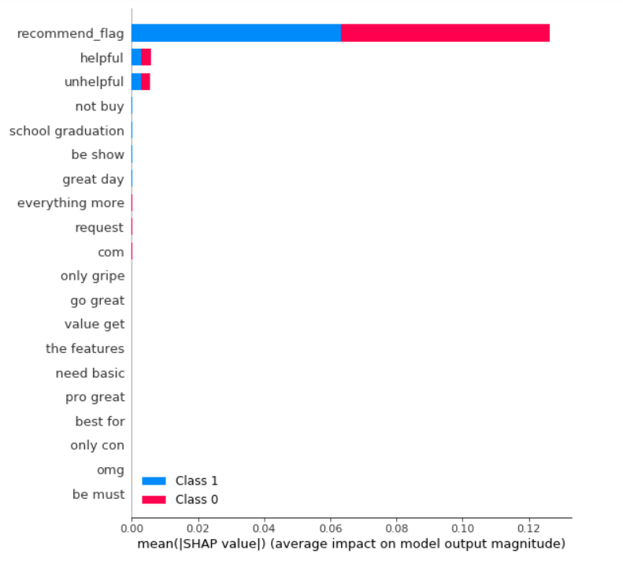
Choosing the Model
Decision Tree
- Easy to interpret
- Able to capture inter-feature relations
Logistic Regression
- Easy to interpret
- Can focus on individual features

Slide 11
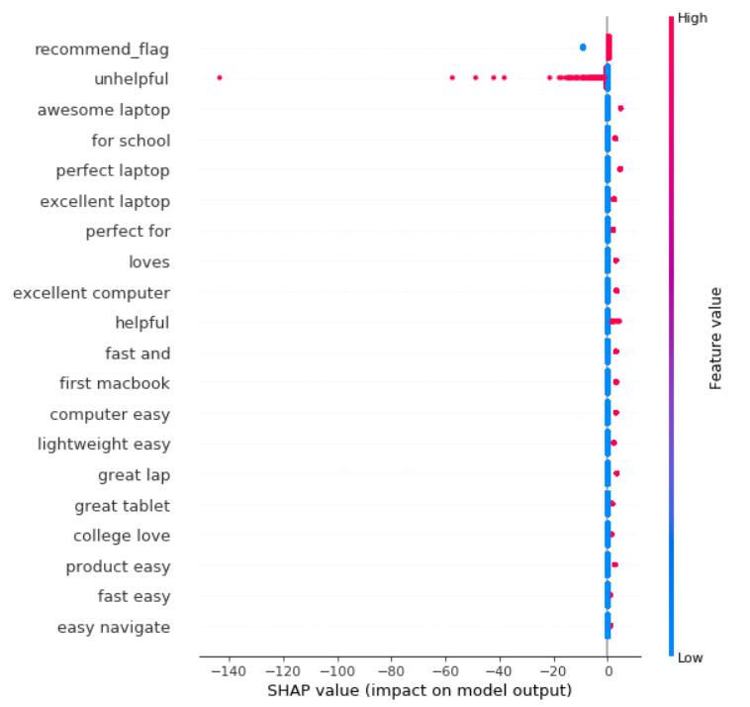
Choosing the Model
Decision Tree
- Easy to interpret
- Able to capture inter-feature relations
Logistic Regression
- Easy to interpret
- Can focus on individual features

Slide 12
Grid Search
Model hyperparameter tuning
- In order to prevent over-fitting of the models, the hyperparameters have been optimized:
1) max_depth (decision tree)
2) max_leaf_nodes (decision tree)
3) min_sample_leaf (decision tree)

Slide 13
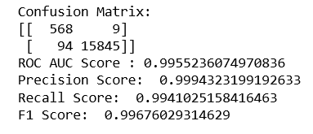
Logistic Regression Results

Slide 14
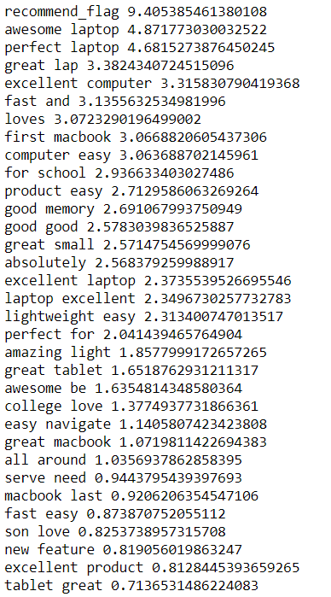
Logistic Regression Importance Scores

Slide 15
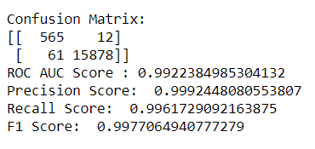
DecisionTreeClassifier Results

Slide 16
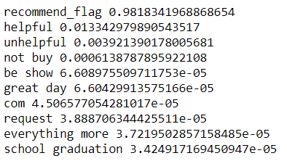
DecisionTreeClassifier Importance Scores

Slide 17
Analysis
Upon further analysis on the test set, we can gain further insights on what features of laptops yield high ratings:
- easy to navigate
- fast / quick
- light weight
- reliable
- easy setup
We can also extract different usages of laptops:
- school / college use

Slide 18
Future Work
Bigger dataset
Feature engineering:
- Clustering
- Topic modeling
Extensive analysis on negative samples
Finding ways to incorporate different rating categories (ratings of 2,3 and 4)

